Slide 1


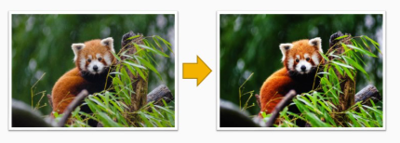
Session 5 :
Image Manipulation - Brightness & Contrast

Slide 2
What is Brightness & Contrast?
Brightness: How "light" or "dark" the whole image is. Example: Turning up your phone’s brightness at night.
Contrast: The difference between the darkest and brightest parts. Example: A black cat on a white pillow (high contrast) vs. a foggy day (low contrast).

Slide 3
How Computers Adjust Brightness & Contrast
Pixels: Images are made of tiny dots called pixels.
Pixel Values:
Grayscale: 0 (black) to 255 (white).
Color: Three values (Red, Green, Blue).
Formula: New Pixel = (Old Pixel × Contrast) + Brightness
Contrast = Scaling factor (e.g., 1.5 = increase contrast).
Brightness = Added value (e.g., +50 = brighter).

Slide 4
Code for Load Image
import cv2
import numpy as np
# Load image (replace "flower.jpg" with your photo!)
image = cv2.imread("flower.jpg")
gray = cv2.cvtColor(image, cv2.COLOR_BGR2GRAY) # Convert to grayscale

Slide 5
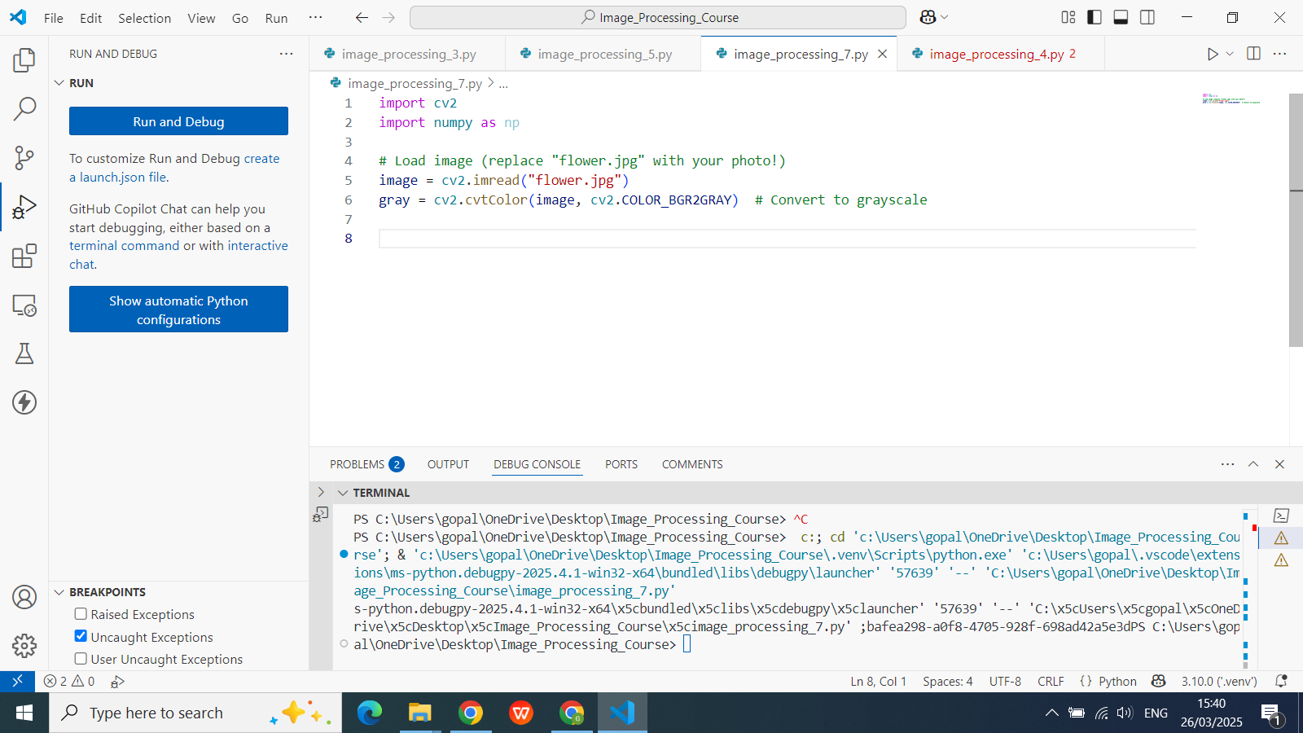

Slide 6
Adjust Brightness & Contrast
import cv2
import numpy as np
# Load image (replace "flower.jpg" with your photo!)
image = cv2.imread("flower.jpg")
gray = cv2.cvtColor(image, cv2.COLOR_BGR2GRAY) # Convert to grayscale
alpha = 1.5 # Contrast (1.0 = no change, >1.0 = more contrast)
beta = 30 # Brightness (0 = no change, +50 = brighter)
# Apply formula: new_pixel = alpha*old_pixel + beta
adjusted = np.clip(alpha * gray + beta, 0, 255).astype(np.uint8)

Slide 7
Show Results
import cv2
import numpy as np
# Load image (replace "flower.jpg" with your photo!)
image = cv2.imread("flower.jpg")
gray = cv2.cvtColor(image, cv2.COLOR_BGR2GRAY) # Convert to grayscale
alpha = 1.5 # Contrast (1.0 = no change, >1.0 = more contrast)
beta = 30 # Brightness (0 = no change, +50 = brighter)
# Apply formula: new_pixel = alpha*old_pixel + beta
adjusted = np.clip(alpha * gray + beta, 0, 255).astype(np.uint8)
cv2.imshow("Original", gray)
cv2.imshow("Brighter & Sharper", adjusted)
cv2.waitKey(0) # Press any key to close
cv2.destroyAllWindows()

Slide 8
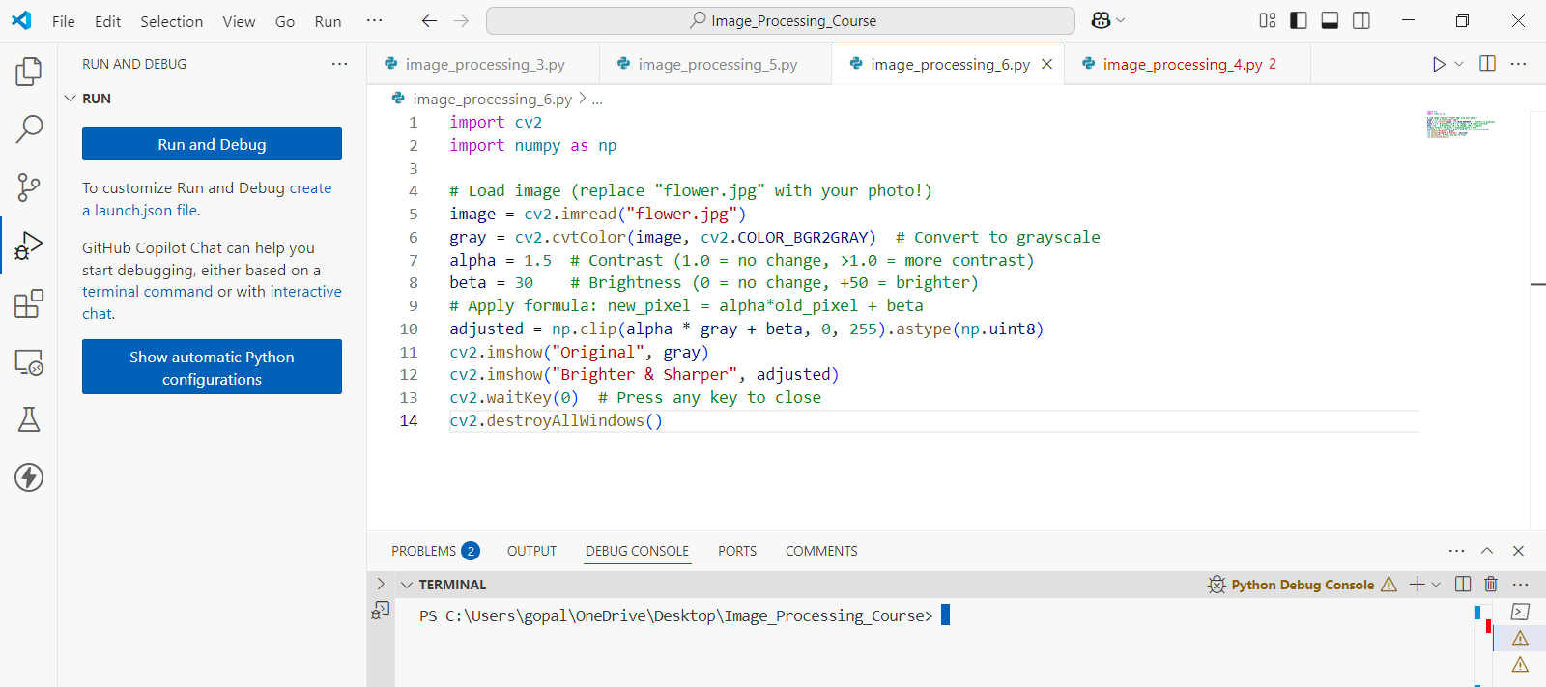

Slide 9
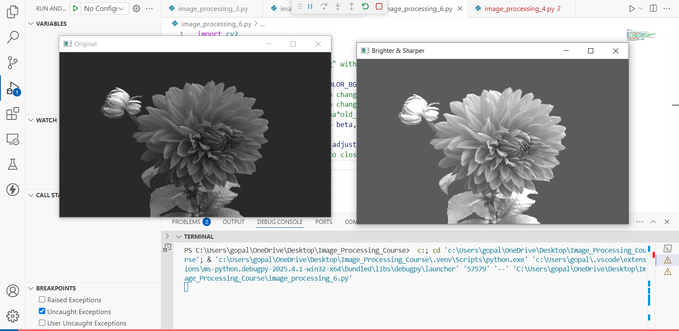
Code Output :

Slide 10
Real-Life Examples
Brighten a Dark Photo: Take a dim selfie and make it sunny! ☀️
Enhance Contrast: Turn a foggy mountain into a crisp postcard! 🏔️
Try This!
Set alpha = 0.5 and beta = -30. What happens?
Use a color image (skip grayscale conversion) and see how colors change!
Why This Matters
Social Media Filters: Apps like Instagram use similar math!
Medical Imaging: Doctors adjust contrast to see X-rays clearly.
Your Challenge: Take a photo of your favorite toy, adjust brightness/contrast, and share it with friends!

Slide 11
Write a Python Script to Modify image brightness and contrast using OpenCV trackbars.
import cv2
# Function to apply brightness and contrast
def update(val):
brightness = cv2.getTrackbarPos('Brightness', 'Image Adjuster') - 100
contrast = cv2.getTrackbarPos('Contrast', 'Image Adjuster') - 100
adjusted = cv2.convertScaleAbs(img, alpha=1 + contrast / 100.0, beta=brightness)
cv2.imshow('Image Adjuster', adjusted)
# Load the image
img = cv2.imread('your_image.jpg') # Replace with your image path

Slide 12
# Create a window
cv2.namedWindow('Image Adjuster')
# Create trackbars for brightness and contrast
cv2.createTrackbar('Brightness', 'Image Adjuster', 100, 200, update)
cv2.createTrackbar('Contrast', 'Image Adjuster', 100, 200, update)
# Initialize with original image
update(0)
# Wait until user presses a key
cv2.waitKey(0)
cv2.destroyAllWindows()

Slide 13
Write a Python Script to Modify image brightness and contrast using OpenCV trackbars.
How It Works:
cv2.getTrackbarPos() reads the current position of the trackbar.
Brightness and contrast are adjusted using cv2.convertScaleAbs() where:
alpha = 1 + contrast/100 controls contrast.
beta = brightness controls brightness.
Trackbars are set from 0–200 with 100 as the neutral point. Requirements:
Make sure OpenCV is installed:
pip install opencv-python

Slide 14
Exercise
1. What does increasing the 'contrast' in an image do? A. Makes the image blurrier B. Increases the difference between dark and light areas C. Converts the image to grayscale D. Makes the image smaller
Correct Answer: B. Increases the difference between dark and light areas
2. What pixel value range is used in grayscale images? A. 1 to 100 B. 0 to 100 C. 0 to 255 D. 1 to 255
Correct Answer: C. 0 to 255

Slide 15
Exercise
1. What does increasing the 'contrast' in an image do? A. Makes the image blurrier B. Increases the difference between dark and light areas C. Converts the image to grayscale D. Makes the image smaller
Correct Answer: B. Increases the difference between dark and light areas
2. What pixel value range is used in grayscale images? A. 1 to 100 B. 0 to 100 C. 0 to 255 D. 1 to 255
Correct Answer: C. 0 to 255

Slide 16
Exercise
3. Which formula is used to adjust brightness and contrast of a pixel? A. New Pixel = (Old Pixel + Contrast) × Brightness B. New Pixel = Old Pixel / (Contrast + Brightness) C. New Pixel = (Old Pixel × Contrast) + Brightness D. New Pixel = (Old Pixel - Brightness) / Contrast
Correct Answer: C. New Pixel = (Old Pixel × Contrast) + Brightness
4. In OpenCV, which function ensures pixel values remain in the 0–255 range? A. cv2.normalize() B. np.clip() C. cv2.threshold() D. np.scale()
Correct Answer: B. np.clip()

Slide 17
Exercise
5. What is the default "neutral" value for the trackbars in the OpenCV script provided? A. 0 B. 50 C. 100 D. 255
Correct Answer: C. 100

